Slide 1




Potential health and economic impact of paediatric vaccination using next generation influenza vaccines in Kenya: a modelling study
Naomi R Waterlow, Sreejith Radhakrishnan, Jeanette Dawa, Edwin van Leeuwen, Philipp Lambach, Joseph Bresee, Marie Mazur, Rosalind M Eggo, Mark Jit

Slide 2


Why do we need to evaluate the vaccines now?
Key questions
‘Full Vaccine Value Assessment’ or FVVA, and is considered a critical analysis to inform prioritization for investment and eventual uptake. - WHO
“Should we invest in developing a universal flu vaccine?”
“Should we recommend/fund a universal flu vaccine?”
“Should we introduce a universal flu vaccine?”
Notes:
Discuss alignment with full value of vaccine asseseement
End up with vaccines that are not within the spec required. E.g. (dengue or malaria – forgot need to check)

Slide 3
Next Generation Flu Vaccines: WHO PPC
 | Improved influenza vaccines | Universal influenza A vaccines
Projected year of licensure | 2022 | 2027
Target population | Children 6-59 months old | All clinical risk groups including children 6-59 months old
Duration of protection | At least one year/influenza season (equal or better than current vaccines) | At least 5 years
Clinical efficacy | Better than current vaccines for either vaccine-matched or drifted strains | Better than current vaccines for vaccine-matched AND drifted strains

Slide 4
Main vaccine scenarios of interest
No vaccine
Current vaccines (70/40 efficacy, 6months waning)
Improved vaccines – Minimal (70/40 efficacy, 1 year waning)
Improved vaccines - Breadth (70 efficacy, 3 years)
Improved vaccines - Efficacy (90/70 efficacy, 2 years)
Universal vaccines (90 efficacy, 5 years)
Sensitivity analysis:
75% coverage in target age groups, instead of 50%
infection-derived immunity modelling

Slide 5
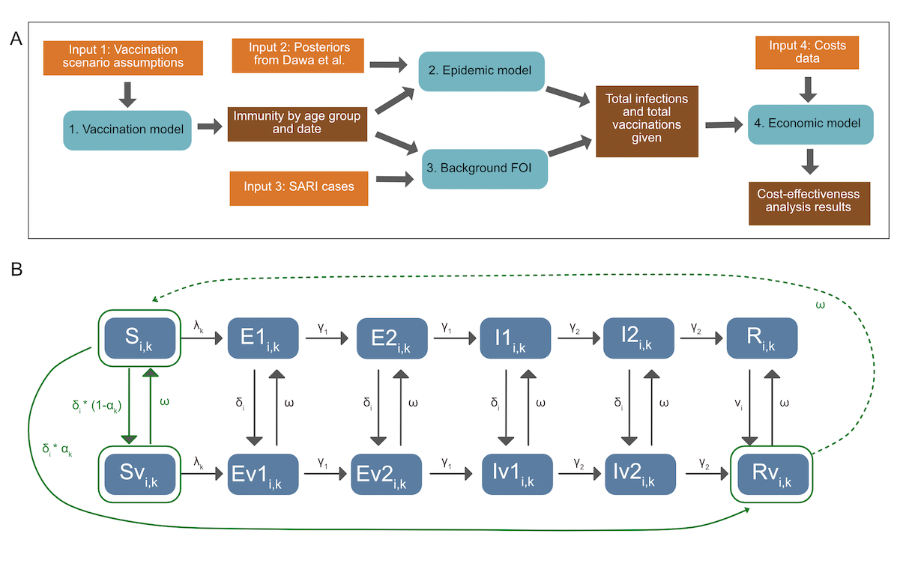
Modelling Overview
2010- 2019, Kenya
What would have happened if we’d had these vaccines then?

Slide 6
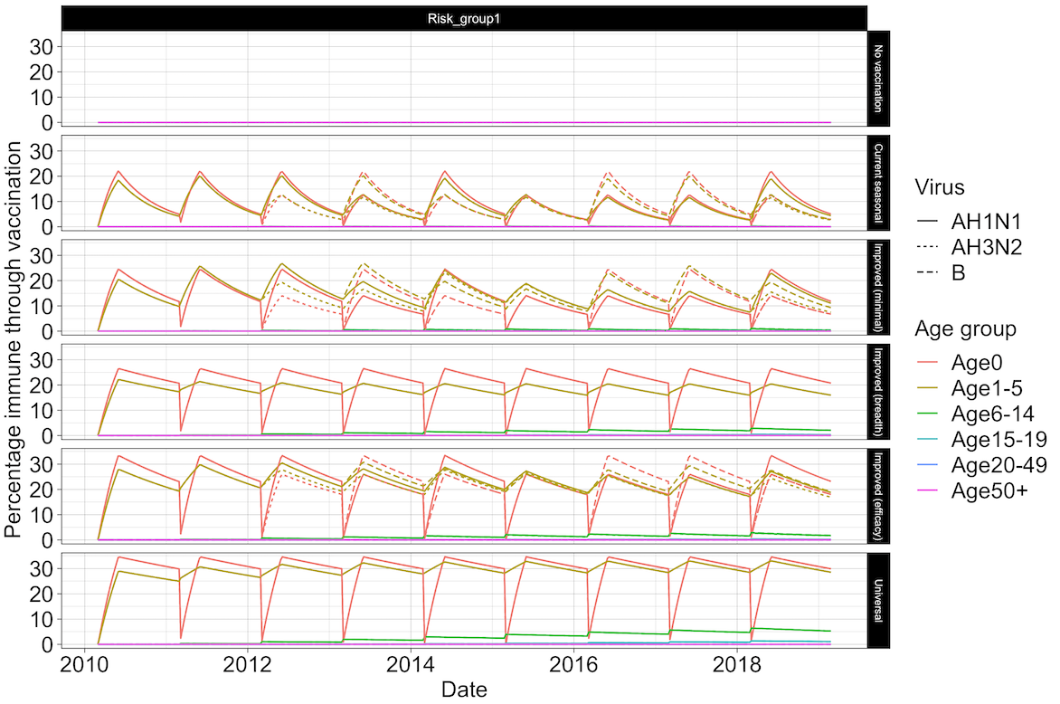
1. Vaccine Model
Vaccine immunity is all-or-nothing
Assume everyone born susceptible
Ageing of population

Slide 7
Infection modelling (Based on Dawa et al. (2020))
Epidemics fit with fluevidencesynthesis R package
SEEIIR epidemic model, with vaccination.
Parameters estimated: transmissibility, age-specific susceptibility, age-specific ascertainment rates, initial number of infections

Slide 8
2. Epidemic model (Based on Dawa et al. (2020))
States are: Susceptible (S), Exposed (E), Infectious (I) and Recovered (R), and their vaccinated counterparts (Sv, Ev1, Ev2, Iv1, Iv2, Rv).v denotes the vaccinated equivalent of the compartments.
ᵟ is the rate of vaccination in age group i, ⍺ is the efficacy by subtype k, ω is vaccine derived immunity waning.

Slide 9
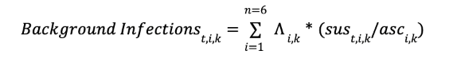
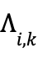
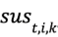
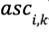
3. Background FOI
Poisson distribution fitted to the weekly observed cases in each age group and across subtype. Scaled by the ascertainment rate to get number of infections, and the vaccine-derived immunity calculated from the vaccine model.
Shape parameter of poisson distribution
Proportion susceptible
Ascertainment rate
i
age group
k
viral subtype
t
week

Slide 10
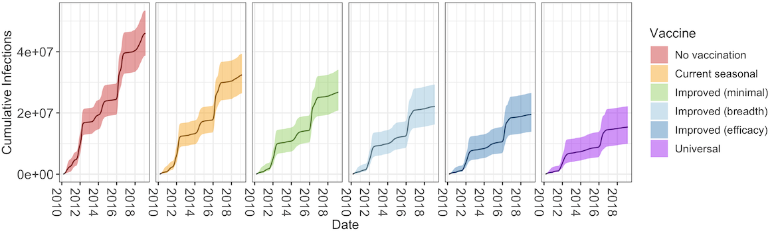
Infections over time
…. Not the same number of vaccines in each scenario!

Slide 11
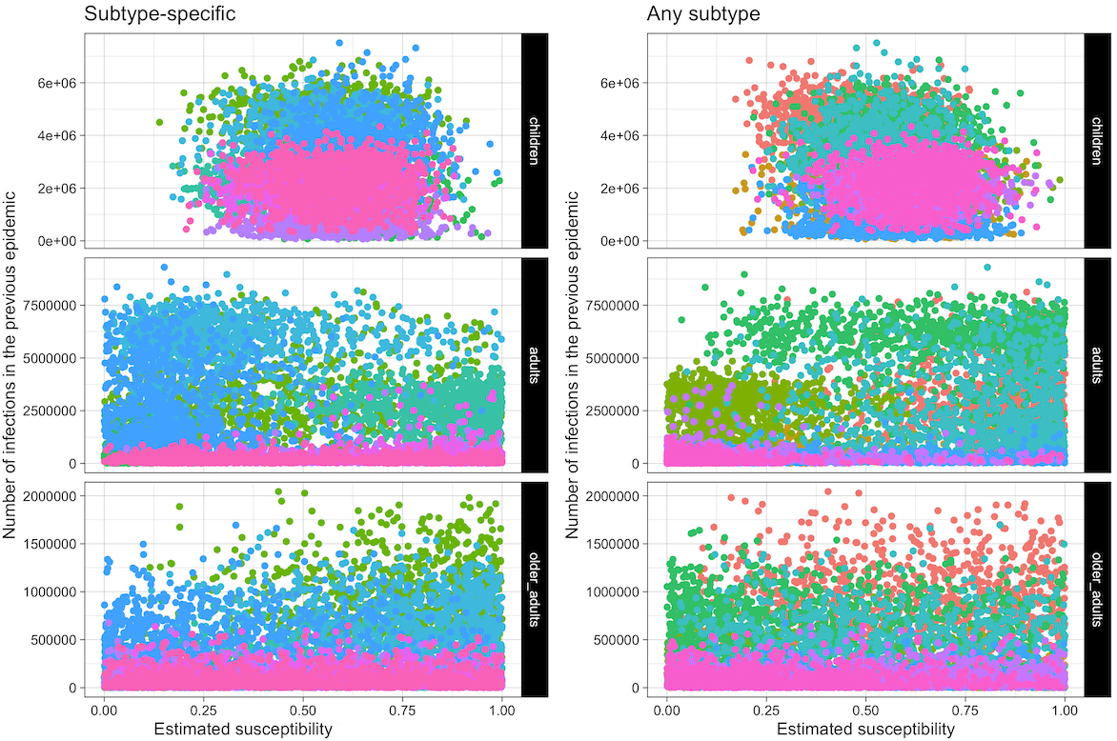
Aside – infection-derived immunity?

Slide 12
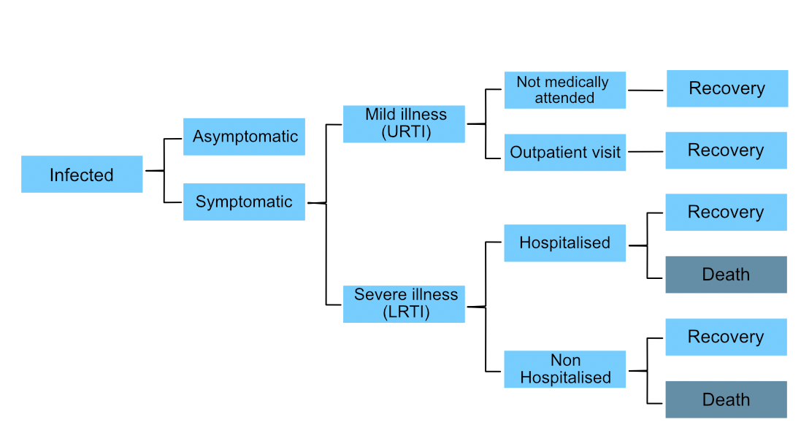
4. Economic analysis

Slide 13
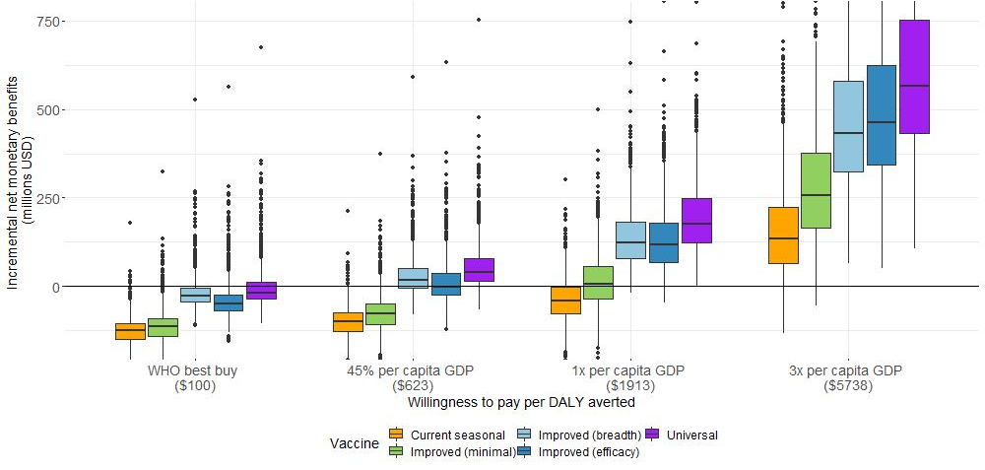
All scenarios can be cost-effective, threshold dependent

Slide 14
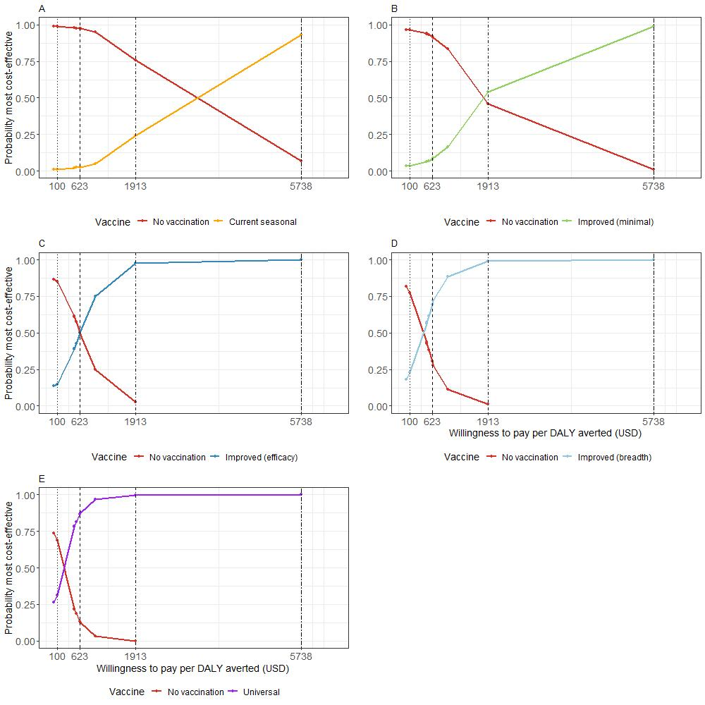
All scenarios can be cost-effective, threshold dependent

Slide 15
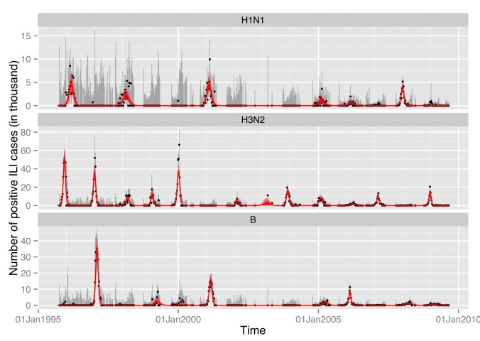
Expanding to other countries
Age group | Low Risk Coverage | High Risk Coverage
<1 | 0 | 0.449
1-4 | 0.438 | 0.449
5-14 | 0.604 | 0.449
15-24 | 0.604 | 0.449
25-44 | 0 | 0.449
45-64 | 0 | 0.449
65+ | 0.724 | 0.724
(Baguelin 2013)

Slide 16







Thanks!
Mark Jit
Professor of Vaccine Epidemiology, LSHTM
Edwin van Leeuwen
UKHSA & LSHTM
Rosalind Eggo
Associate Professor, LSHTM
Honorary position in Vaccine Evaluation, UKHSA
HDR UK Innovation Fellow
Jeannette Dawa
Washington State University – Global Health Programs, Kenya
Investigators
Key collaborators
Naomi Waterlow
Research Fellow, LSHTM
Marie Mazur
Taskforce for Global Health
Sreejith Radhakrishnan
Research Fellow, LSHTM
Joseph Bresee
Taskforce for Global Health

